Slide 1

Memory Management
PASS
CS532: OS Foundations
Lab Assignment
email address: parth2@pdx.edu
partner’s email address:

Slide 2
Instructions: Make a copy of this document, move your copy to your submissions folder and fill the document with your responses. Use the space on each slide to show your responses, and add additional slides as needed.
When ready for grading: complete the lab assignment submission form and include a link to your filled document

Slide 3
Linux utilities: free and pmap
For this assignment you will need to use a Linux system such as linux.cs.pdx.edu so that you can run the tools free and pmap.
When logged into linux.cs.pdx.edu use the man command to learn about these tools. Specifically, run these commands and study the output:
man 1 free
man 1 pmap
You will only need a few of the many features provided by these tools.

Slide 4
1. Use free to answer these questions:
A. How much memory is in your system (in gigabytes)?
B. How much is free?
C. Do these numbers match your intuition?

Slide 5
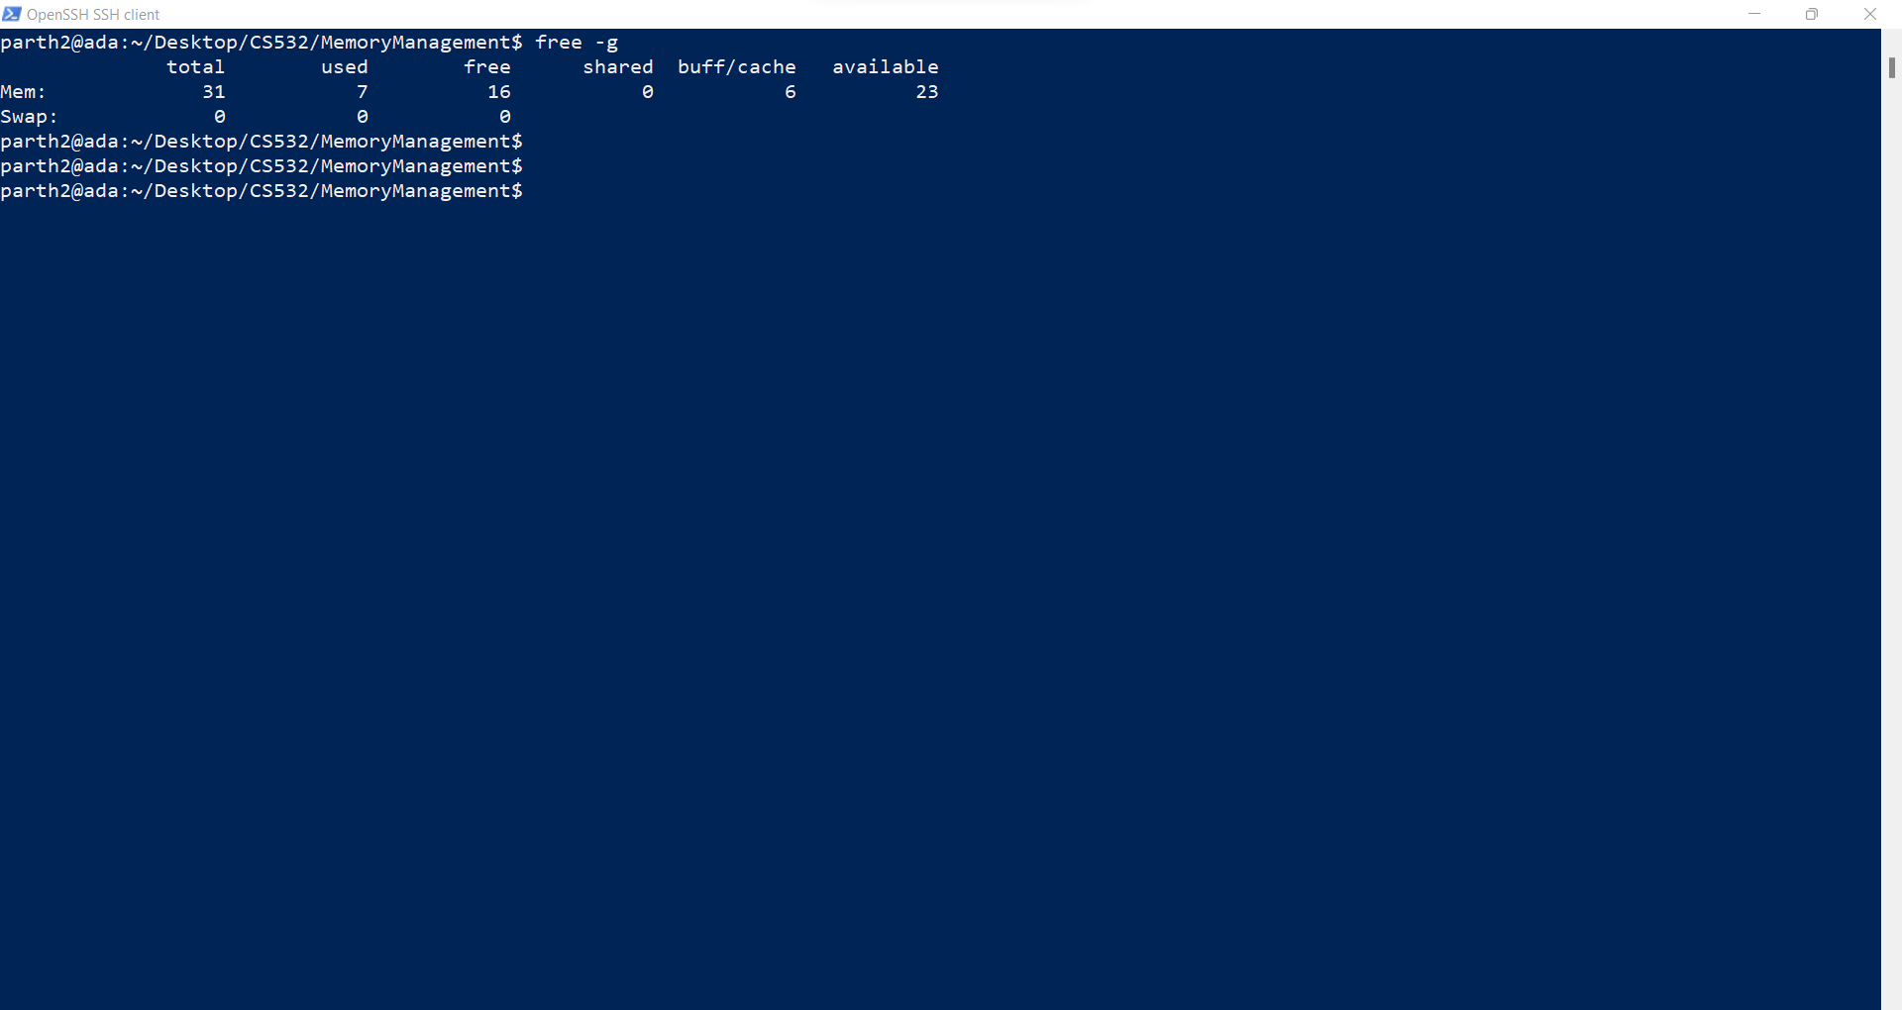
A. How much memory is in your system (in gigabytes)?
Answer: - The total memory in the system is: - 31 GB as given below by the screenshot

Slide 6
B. How much is free?
Answer: - The free memory in the system is 16 GB as given below: -

Slide 7
C. Do these numbers match your intuition?
Answer: - These Numbers match my intuition as has been seen in many computers, the memory utilisation is moderate to high to achieve better efficiency in running the processes.

Slide 8
2. Write, compile and run a C program (call it cs532-memory-user.c) that uses a known amount of memory. This program should take one command line argument: the number of megabytes of memory to allocate. When run, it should allocate an array of this size and repeatedly iterate through the array, touching each entry. The program should do this indefinitely until the user stops it with Ctrl-C.

Slide 9
#include <stdio.h>
#include <stdlib.h>
int main (int argc, char *argv[])
{
if (argc == 2)
{
printf ("The first argument supplied is:- %s\n", argv[0]);
printf ("The second argument supplied is %s\n", argv[1]);
}
else if (argc > 2)
{
fprintf(stderr, "Too many arguments supplied.\n");
return -1;
}
else
{
fprintf(stderr,"More arguments expected.\n");
return -1;
}

Slide 10
long long int size = (long long int) atoi(argv[1]);
long long int size_in_bytes = size * 1024 * 1024;
printf("allocating %lld bytes (%.2f MB)\n",size_in_bytes, size_in_bytes / (1024 * 1024.0));
int *x = malloc(size_in_bytes);
if (x == NULL) {
fprintf(stderr, "memory allocation failed\n");
return -1;
}
long long int num_ints = size_in_bytes / sizeof(int);
printf(" number of integers in array: %lld\n", num_ints);
long long int i = 0;
for (i = 0; i < num_ints; ++i)
{
x[i] = i + 1;
}
while (1)
{
for (i = 0; i < num_ints; ++i)
{
x[i] = x[i] + 1;
}
}
return 0;
}
This code looks good!

Slide 11
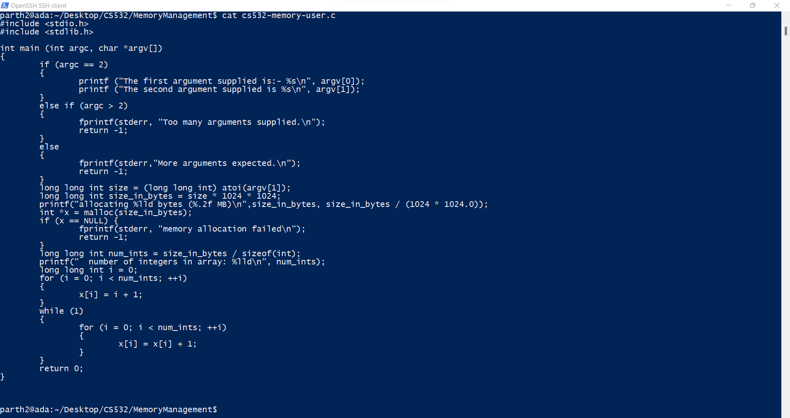

Slide 12
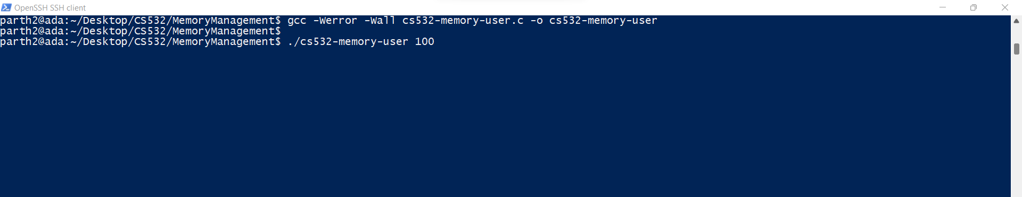
Compiling the program and running it gives us the following screen: -

Slide 13
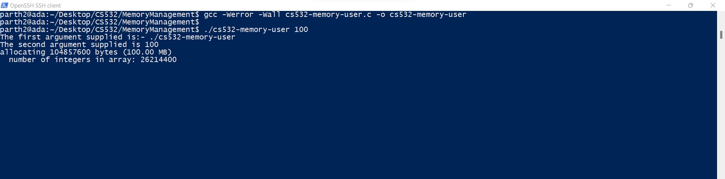
loop will assign the elements and iterate it infinitely till ctrl+c is inputted as given below:-

Slide 14
3. Now, while running your cs532-memory-user program, also (in a different terminal window, but on the same machine) run the free tool.
A. How do the memory usage totals change when your program is running?
B. How about when you terminate the cs532-memory-user program? Do the numbers match your expectations?

Slide 15
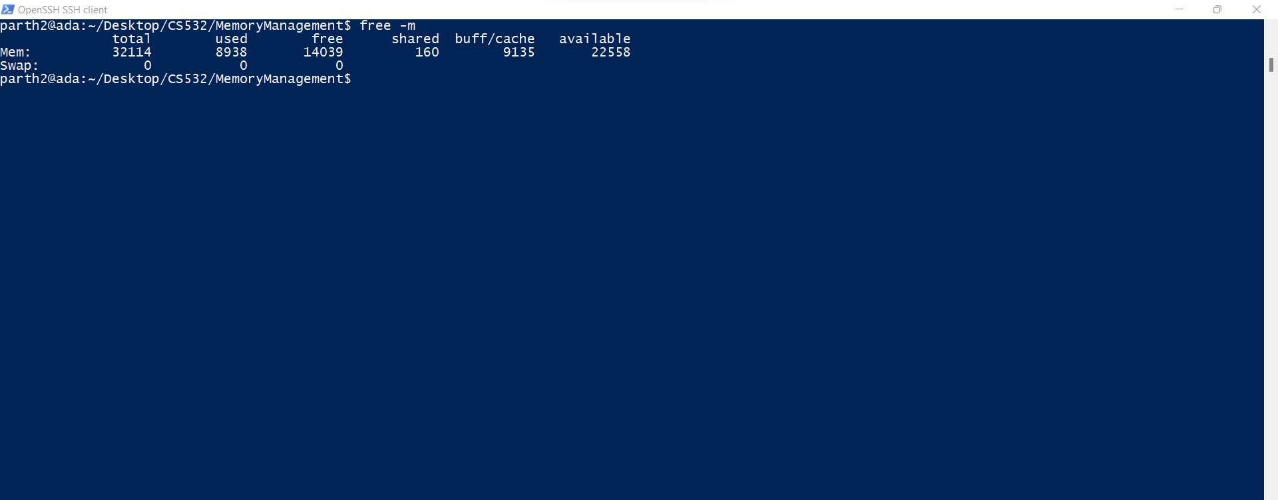
A. How do the memory usage totals change when your program is running?
Answer:- Before the program is executed (in MB):-

Slide 16
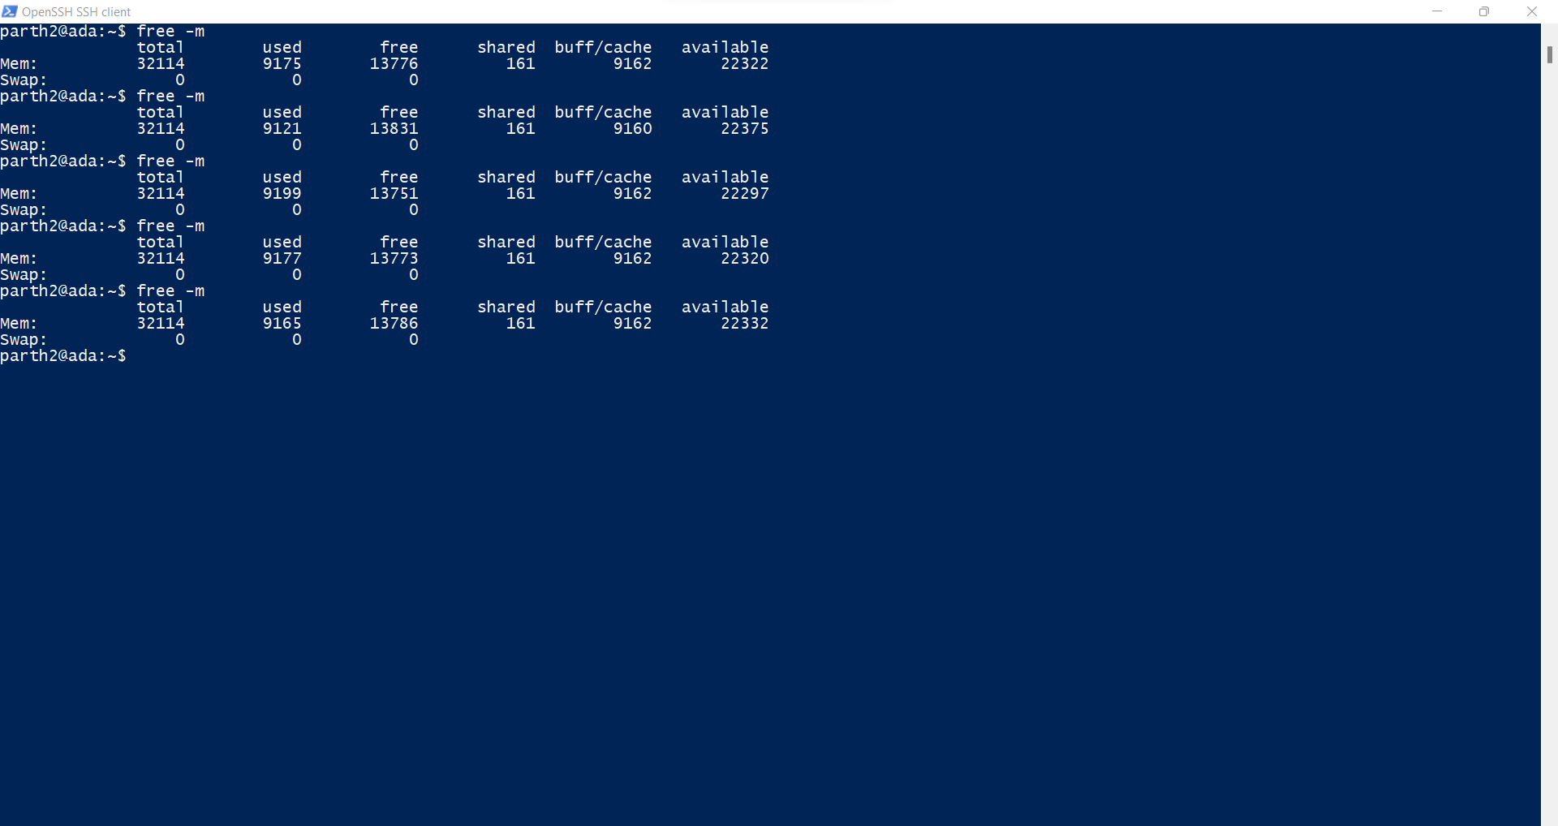
After the program is run: -
When the program starts executing, the free memory starts decreasing until a certain point after which it oscillates between similar values depending on the program we have run.

Slide 17
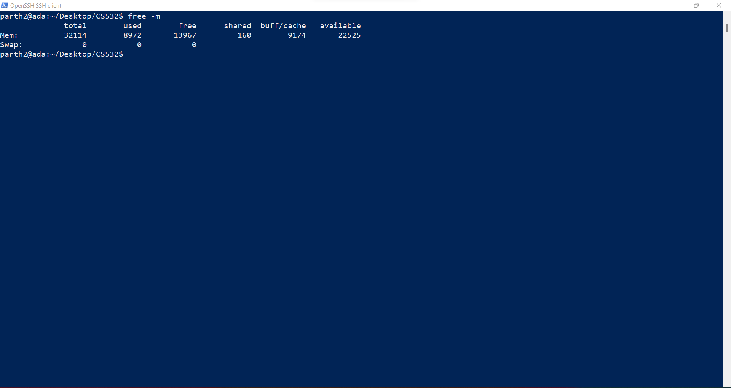
B. How about when you terminate the cs532-memory-user program? Do the numbers match your expectations?

Slide 18
When we have terminated the program, then in the free memory stats, we can see that the used memory decreases significantly and the free memory increases.
This is in accordance with my intuition because when a process is in execution, it is continuously using certain amount of memory which leads to a decrease in free memory and increase in the used memory.
When we terminate the process, the memory used by the process is released in parts and are added to the free memory.
This can be verified by the stats in the screenshots in the previous slides.

Slide 19
C. Fill the following table using your cs532-memory-user program and the free utility. Record the amount of free memory (in megabytes) before, during and after running cs532-memory-user utilizing each corresponding amount of memory.
 | before | during | after
10 MB | 13130 | 13121 | 13150
100 MB | 13236 | 13034 | 13101
1 GB | 12915 | 11727 | 12755
10 GB | 12758 | 11205 | 12655
100 GB | Memory Allocation Failure | Memory Allocation Failure | Memory Allocation Failure
These Figures are in MB(s).
Results look OK

Slide 20
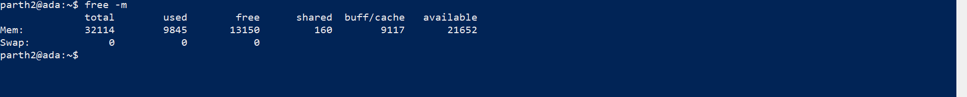
BEFORE
DURING
AFTER
For 10MB as an input, the free -m above shows the before, during and after image respectively.

Slide 21
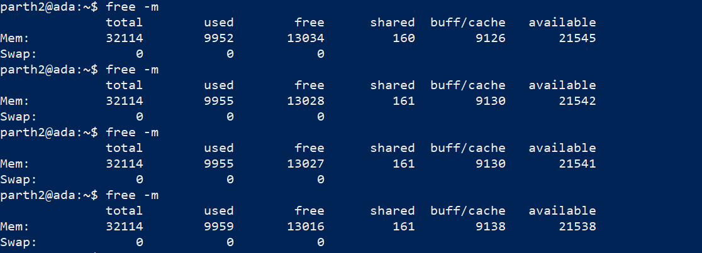
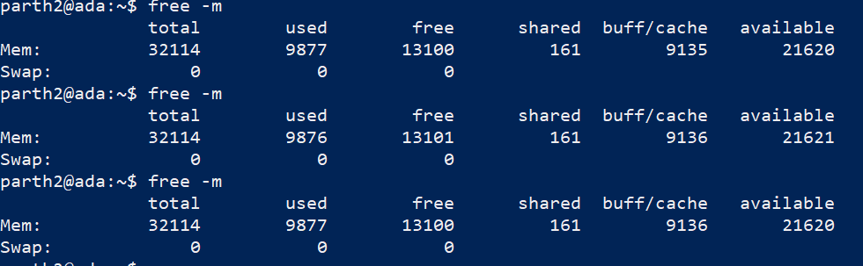
BEFORE
DURING
<----------AFTER
For 100 MB, these are the figures for before, during and after. (3 screenshots)

Slide 22
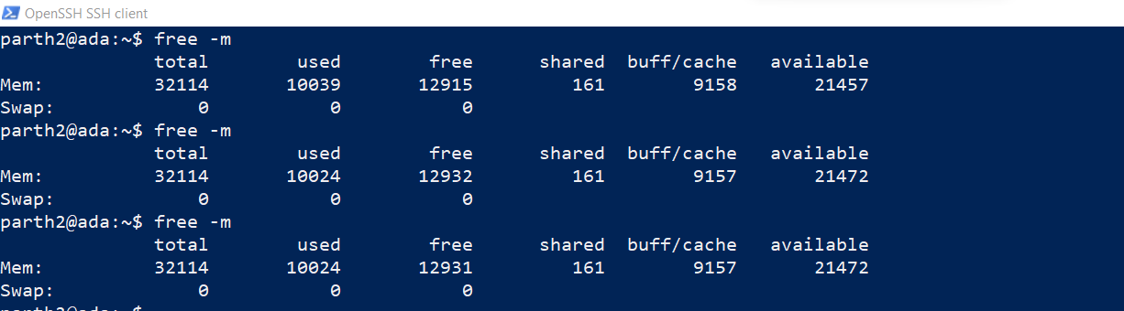
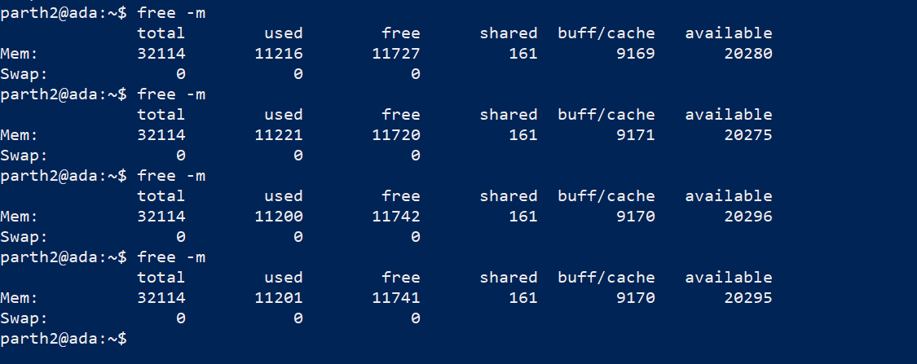
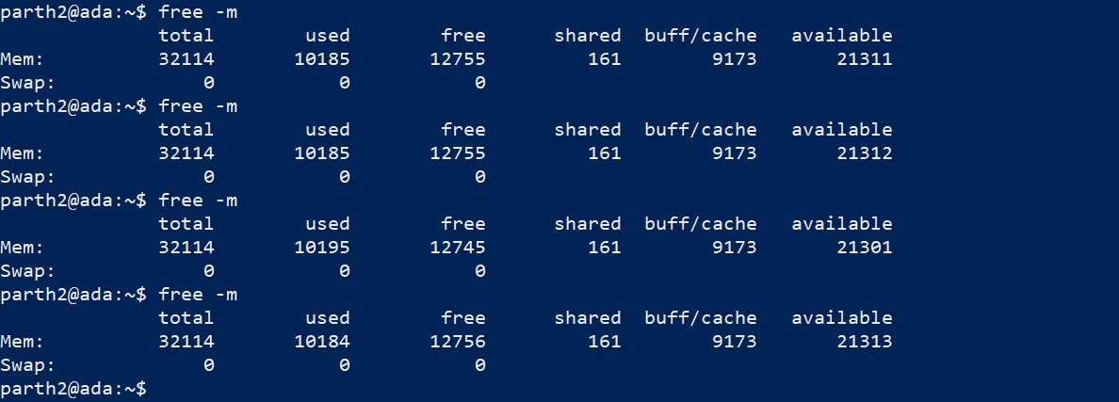
← Before
←During
←After
For 1GB, these are the figures for before, during and after

Slide 23
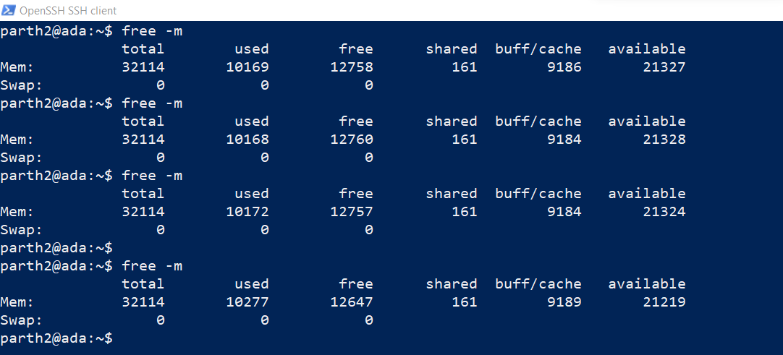
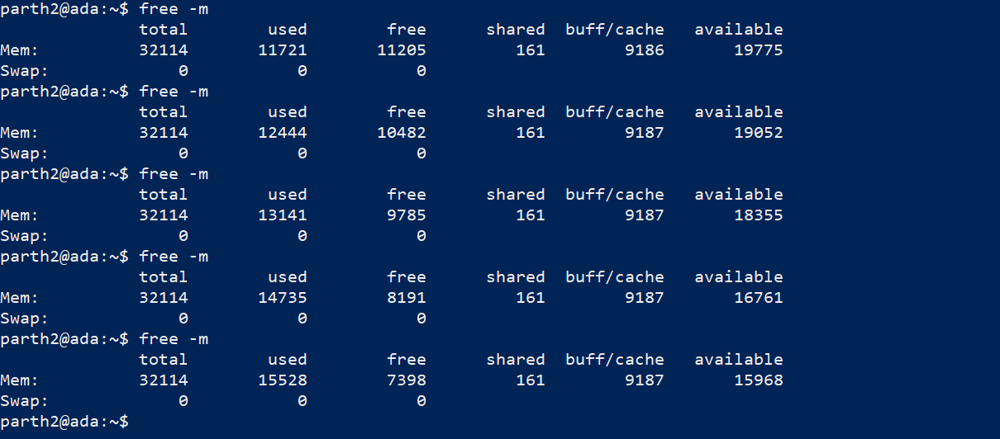
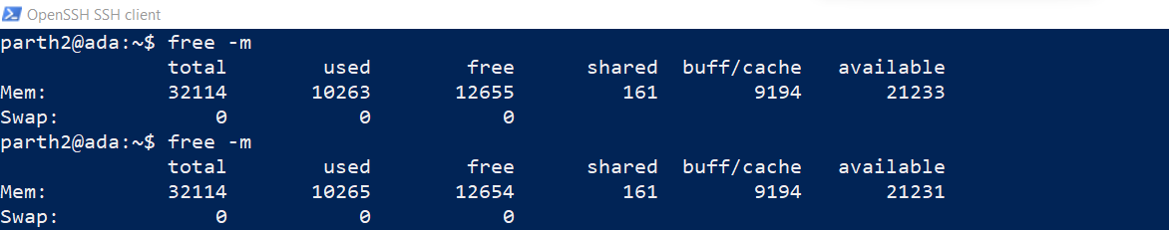
←Before
←During
←After
For 10GB, these are the figures for before, during and after

Slide 24
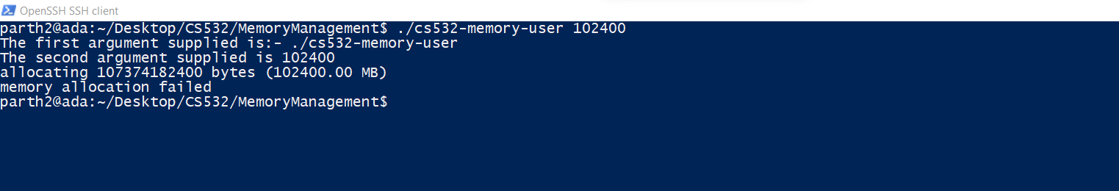
For 100GB, Memory Allocation fails.

Slide 25
To use pmap, you must know the ID of the process to monitor. So, first run your cs532-memory-user program in one terminal window (ask it to allocate 100 megabytes). Then, in a separate terminal window, run ps auxw to see a list of all processes. Within that list, find your running cs532-memory-user program and its pid.
Use pmap to print out the memory map of your cs532-memory-user program.

Slide 26
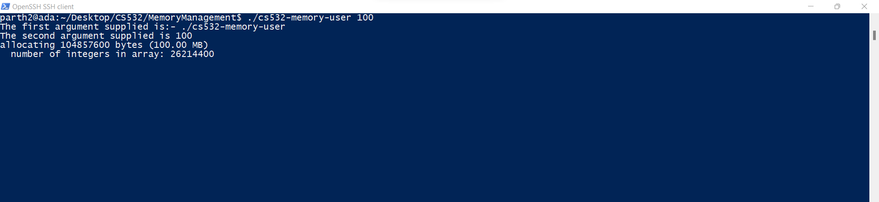
The cs532-memory-user.c program is run with 100 as the argument as given below: -

Slide 27
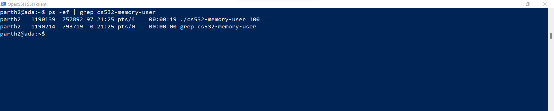
Finding the pid using ps command. It can be achieved in two ways:- using ps -ef | grep <process identifier>
cs532-memory-user 100 (Our process)

Slide 28
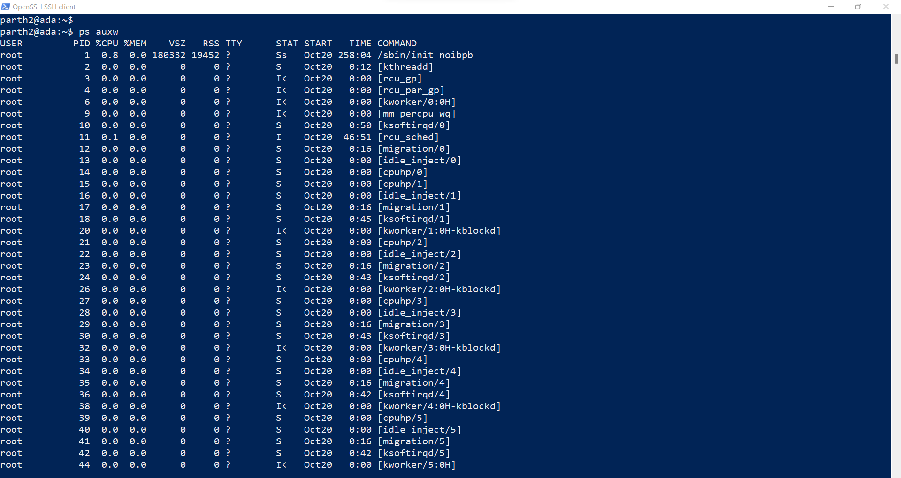
Using ps auxw: -

Slide 29
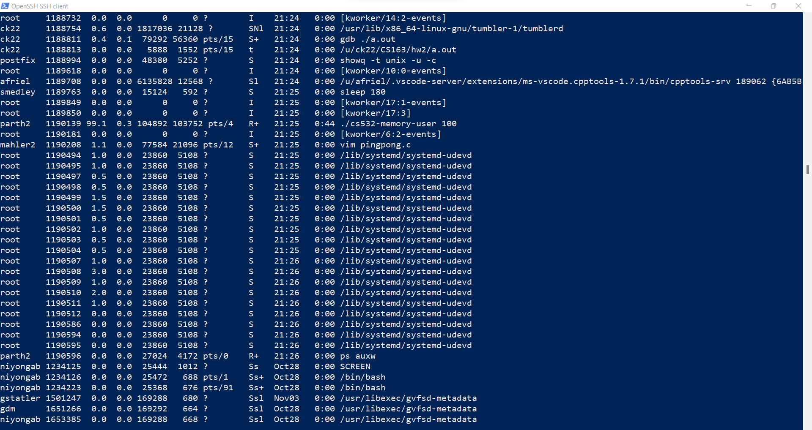
cs532-memory-user 100 (Our process)

Slide 30
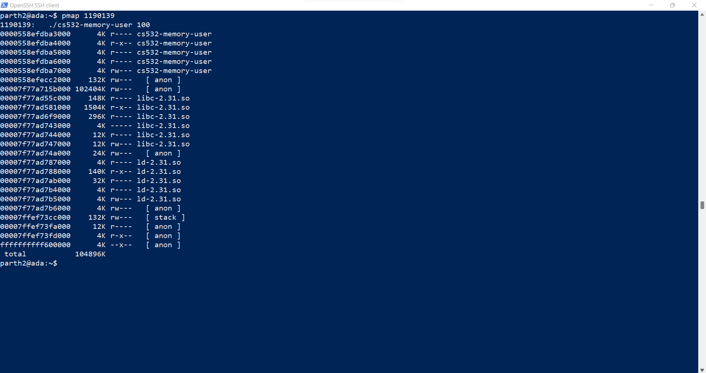
The pmap is given as below:- (using pid as found in the previous steps)

Slide 31
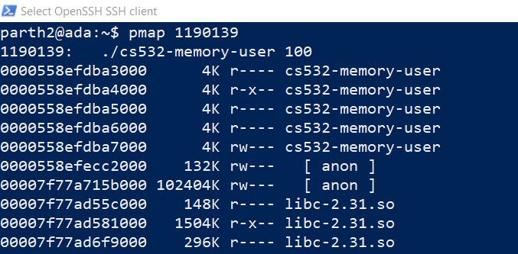
4. Copy and paste a screen capture of the first 10 lines of your pmap output.

Slide 32
5.
A. How many mappings make up the process map for your cs532-memory-user program?
Answer: - 24 mappings
B. What is the smallest size of any mapping shown by pmap?
Answer: - The smallest mapping shown is of size 4K.
The pmap is shown in the screenshot in the subsequent slides.

Slide 33
C. List the 5 largest mappings along with their sizes.
Mapping name | Size (in kilobytes, as reported by pmap)
anon | 102404K
libc-2.31.so | 1504K
libc-2.31.so | 296K
libc-2.31.so | 148K
ld-2.31.so | 140K
Good

Slide 34
